Slide 1

WEB APPLICATION FOR PATHUM DANANSOORIYA CULTURAL ENSAMBLE

Slide 2
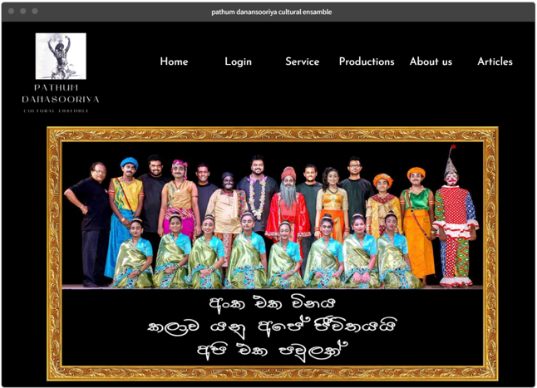
Our Goal
A web Application
that will improve the internal activities of the organization

Slide 3
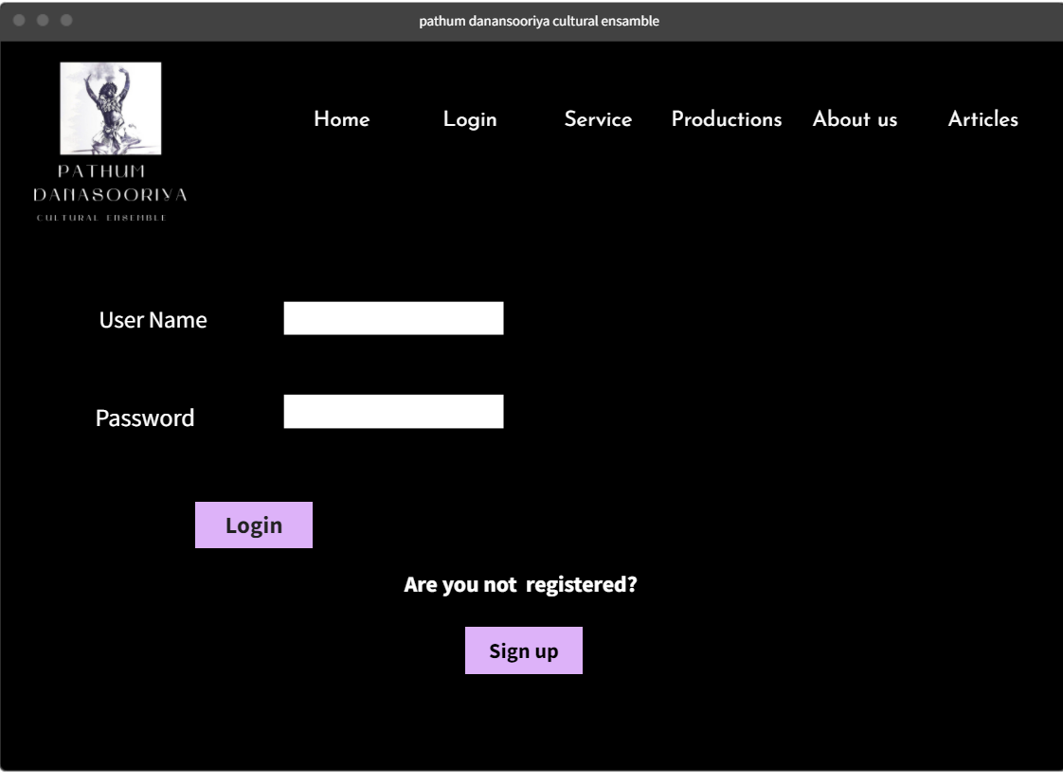
Login

Slide 4
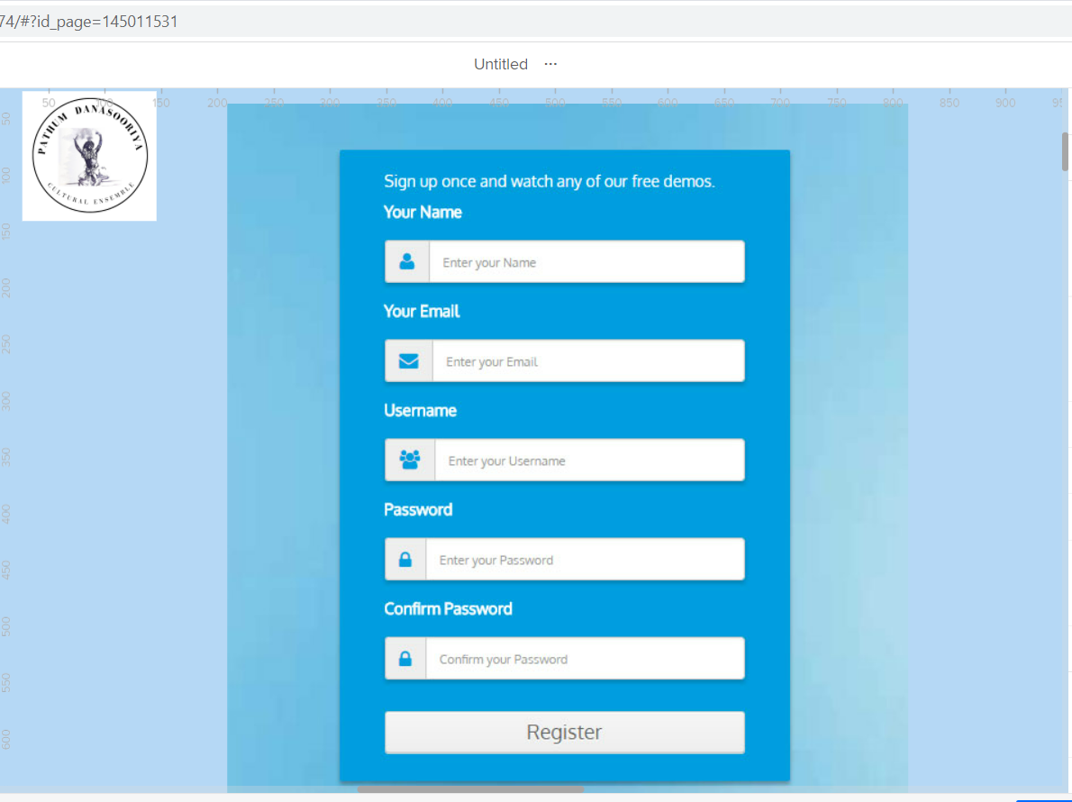
Sign up

Slide 5
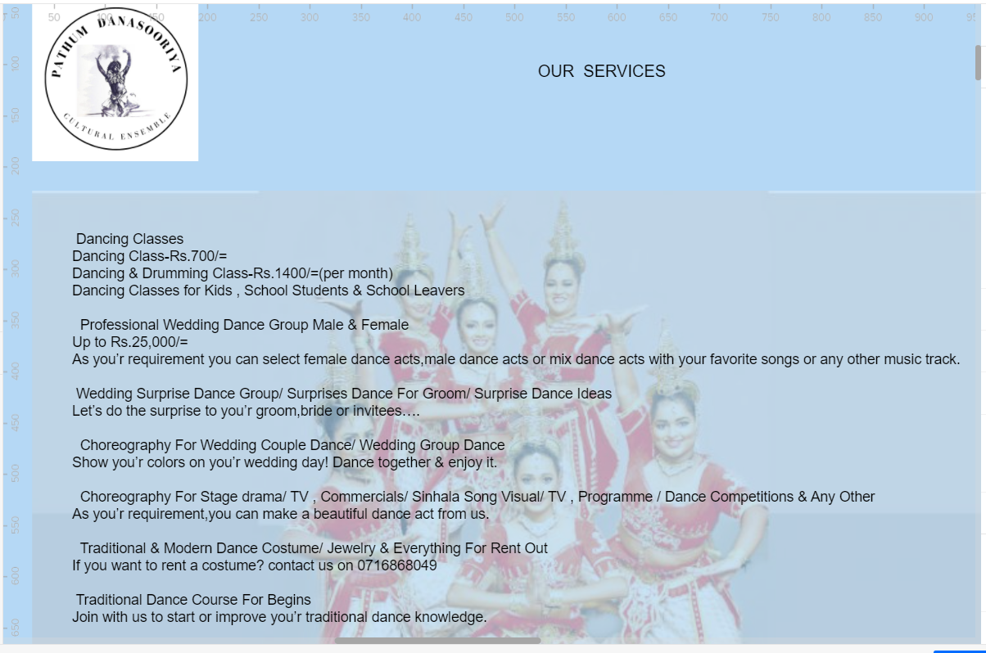
Services

Slide 6
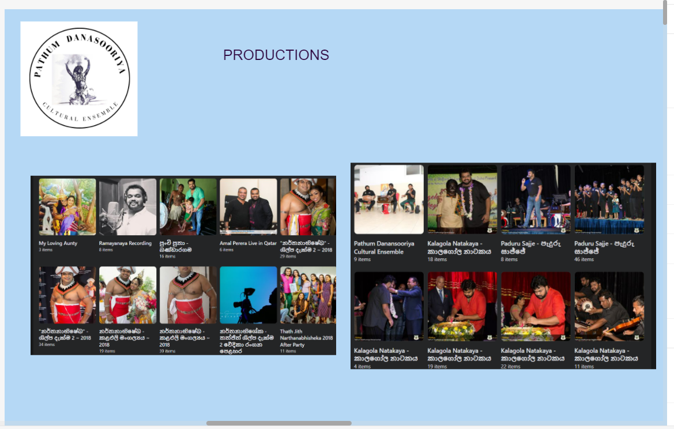
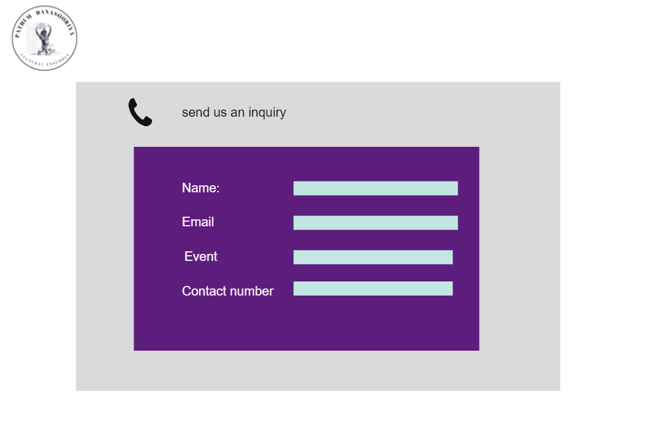
Productions & Inquiries

Slide 7
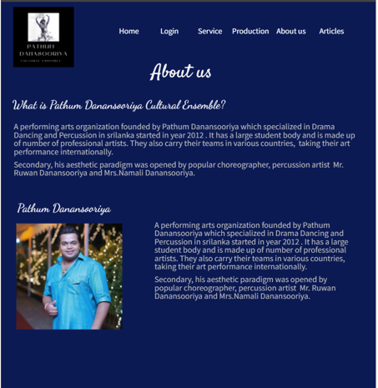
About us

Slide 8
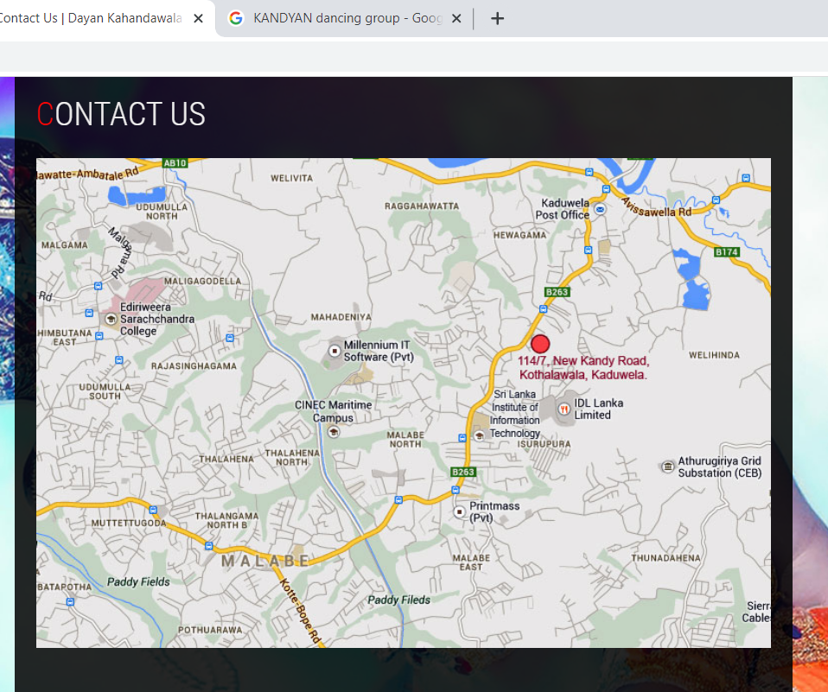
Contact us

